Slide 1
AWS-CLOUD
Presented by,
J.H.Mahalakshmi,
Pragati Engineering College,
IV-IT

Slide 2
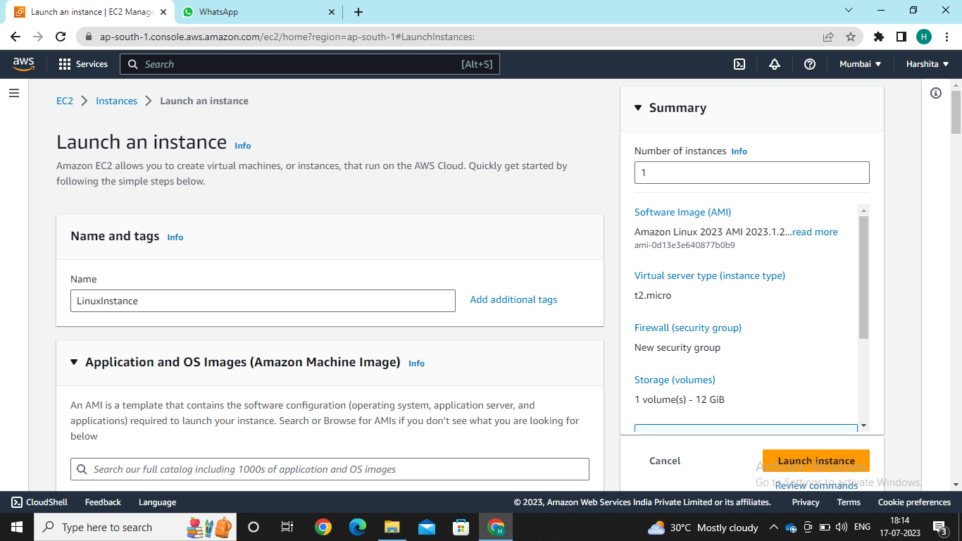
Using SSH Client to connect to Instance using Linux operating System Aws-cloud console->services->compute->EC2->launch instance Select Name & Tags->LinuxInstance ->AMI->Linux OS

Slide 3
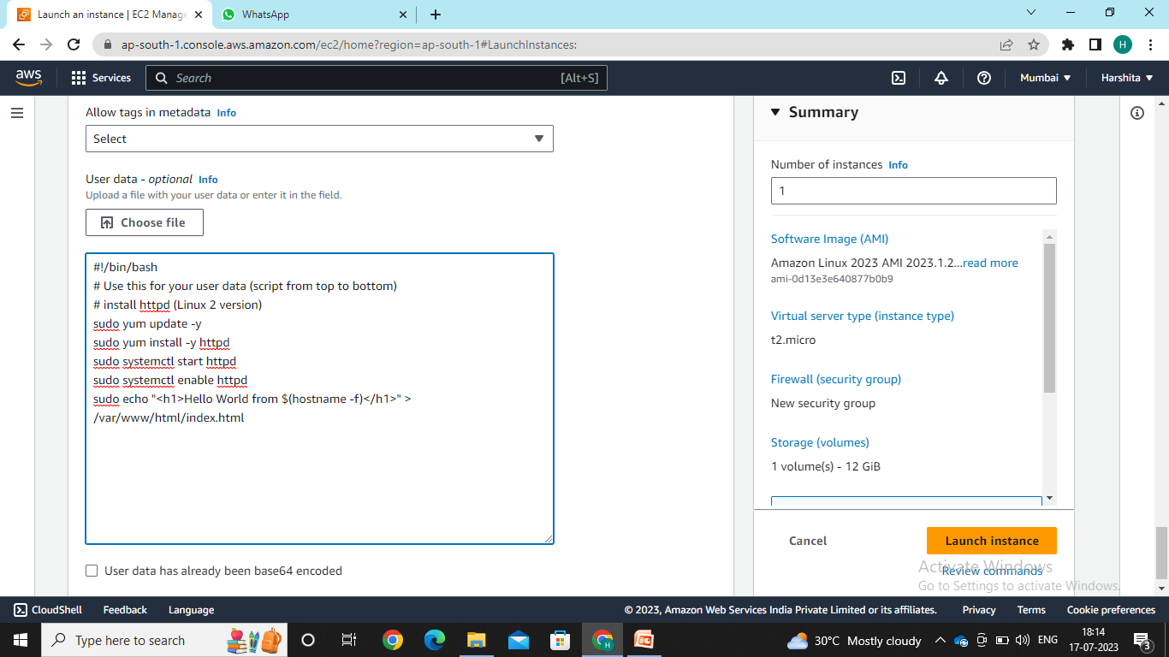
Keep remaining all as default and in advance details in the user data copy paste the following commands as shown and launch instance

Slide 4
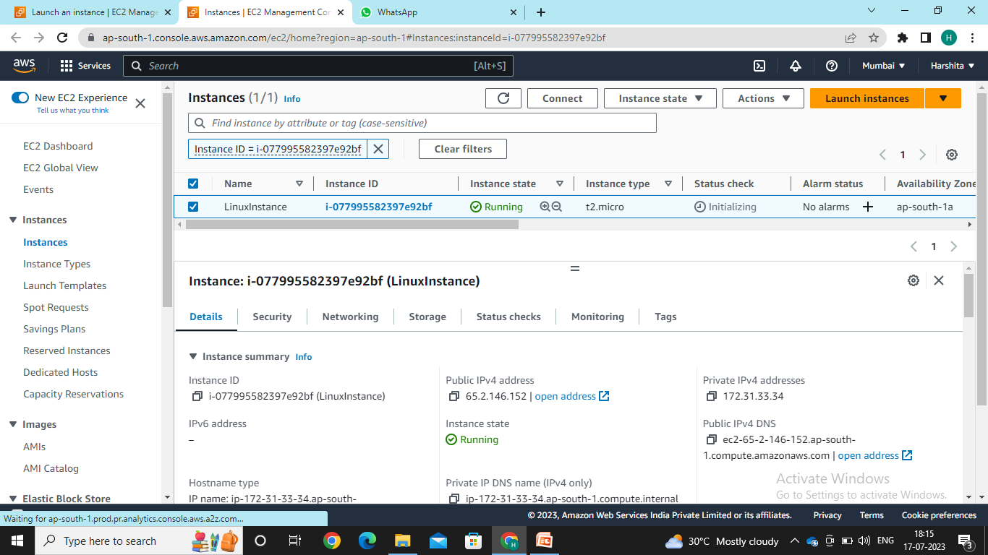

Slide 5
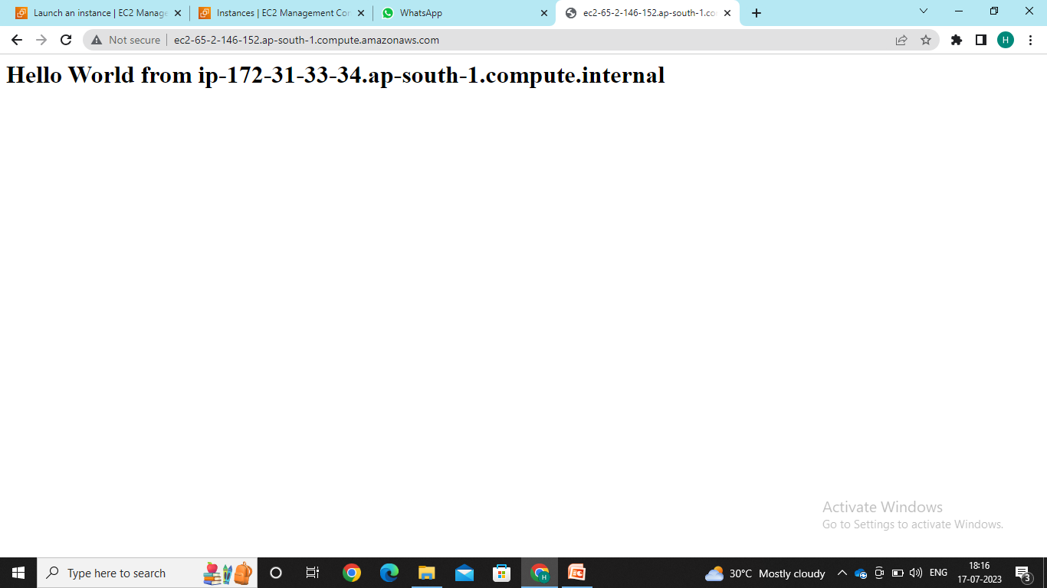

Slide 6
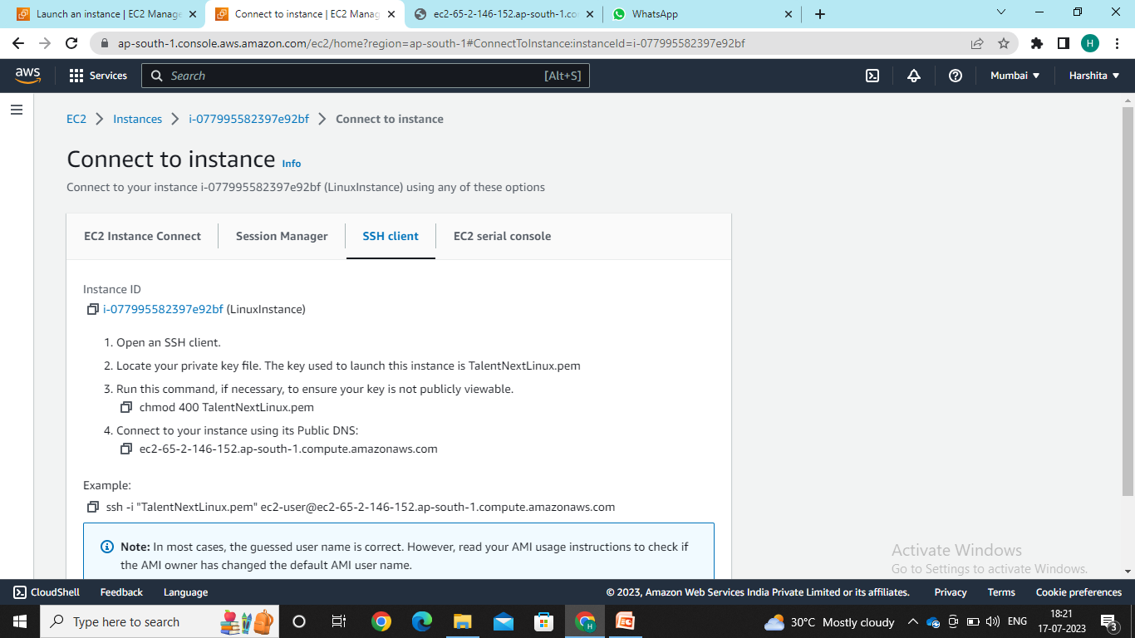

Slide 7
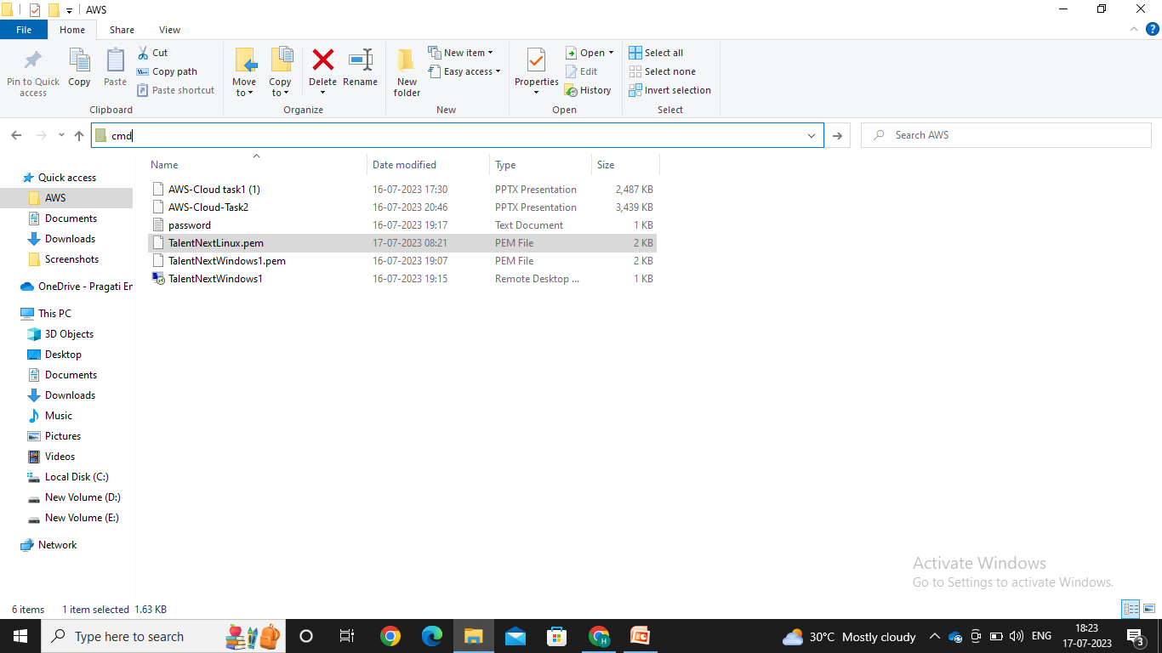

Slide 8
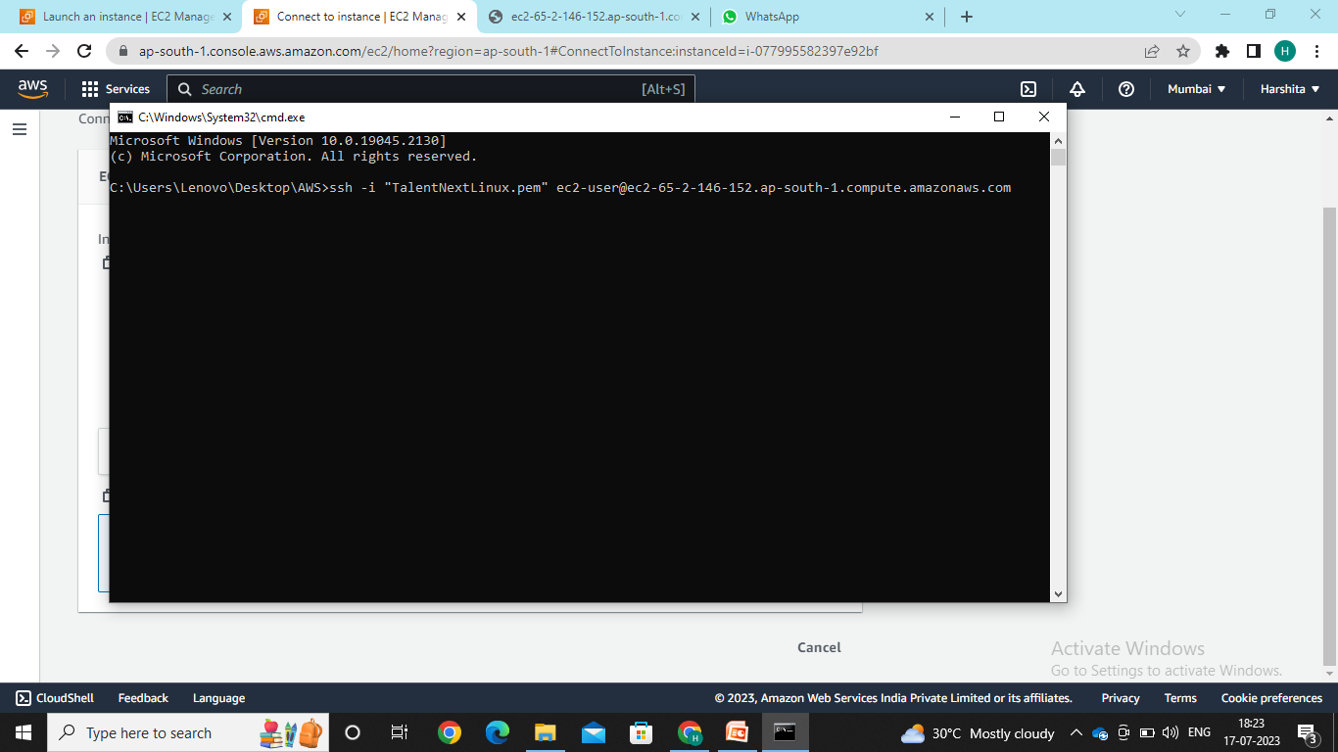

Slide 9


Slide 10


